Slide 1
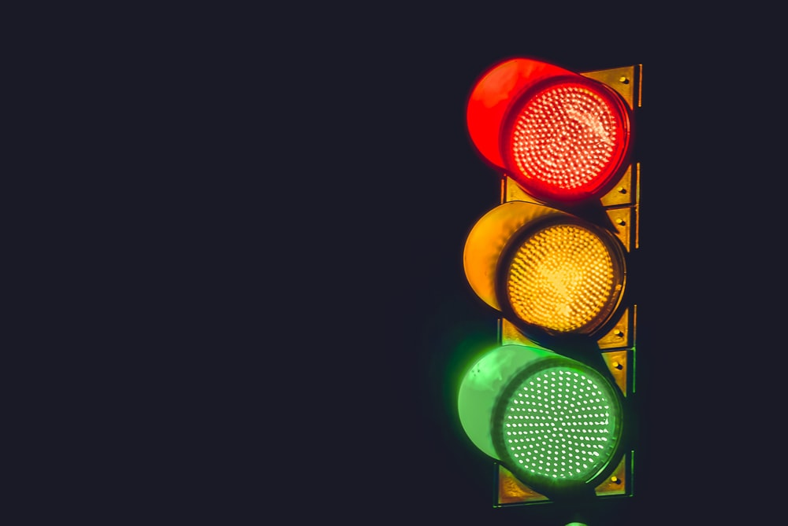
Traffic Light Control
Sprint 1

Slide 2
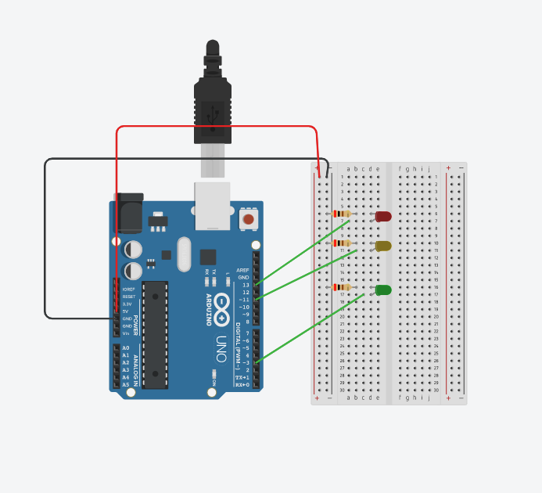
Circuit Diagram
Voltage = 5v
3 leds
3 resistor of 220 ohm

Slide 3
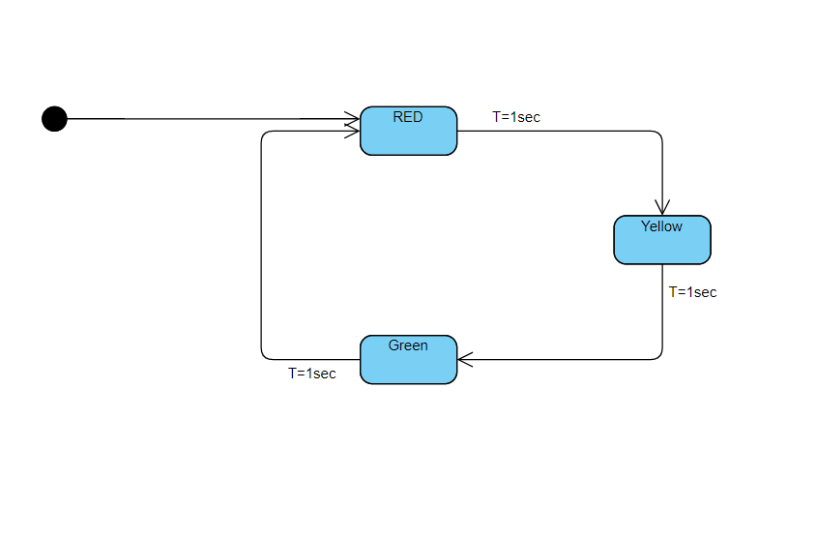
UML DIAGRAM

Slide 4
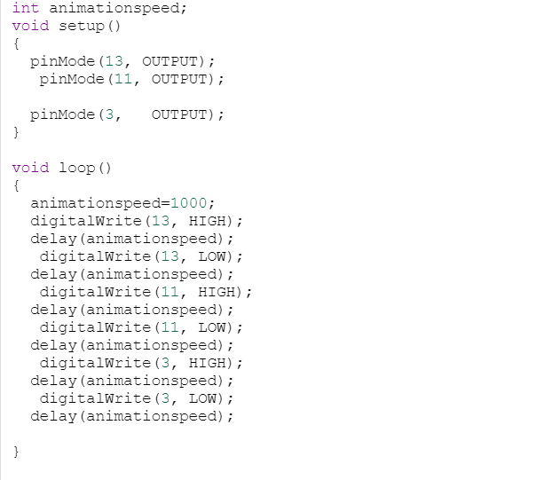
Code

